Slide 1
Notes:
Introduce myself, WPBF
What is the purpose of a children’s ministry?
To make a winsome and fun place that kids love to come to – and by extension to encourage their parents to attend? Well yes, but that isn’t primary purpose.
The primary purpose is the same as the primary purpose of the church:
To make disciples.
There is a growing tendency in American churches today that moves away from this primary purpose. There is a growing burden on Children’s Ministry programs to be “the best hour of that kid’s week”. To offer elaborate facilities, curriculum themed after Disney movies, and a party-like atmosphere. While these desires aren’t wrong in and of themselves, what I submit to you is that there is a higher calling in Children’s Ministry. What we do as ministers to children is a holy responsibility– and worthy of careful consideration.
The fact of the matter is our young people are not the future church. They are the current church. And if our ministry isn’t cultivating that position as part of the church family, we are really doing our children a disservice in their spiritual growth. And, we are cutting off our congregation from the valuable contributions from this group of believers.

Slide 2
Current Church
Meta Curriculum
Making Disciples
Studying the Bible
Learning to Pray
Exploring Theology
Memorizing Scripture
Serving Others
Bearing Fruit
Worshipping God
Notes:
Because kids are part of the current church, it is just as important – maybe more – that they are discipled as it is for the adults.
The meta (or hidden) curriculum of teaching is the aspects of teaching that are implicit; usually unintentional that plays a role in constructing a learner’s image of self, others, and the world.
Example: If a school publicly rewards students who do well on a math test, but not on writing papers, the students could learn that math is more important than writing.
No matter what your values are, they will show in your teaching
What we teach is just as important is how we teach it. What do kids learn by what/how we teach them? This is called the meta curriculum.
We shouldn’t lose sight of the purpose of our ministry – to make disciples (no matter the age). For the purpose of this presentation, I am going to look at discipleship by describing disciplines of the Christian faith. By this, children in our ministry should be:
Learning how to study the Bible
Learning how to pray
Learning how to think
Learning how to serve
Learning how to worship
This is my position – but the lionshare of this presentation is going to be focused on the rubber-meets-the-road practical “how-tos”

Slide 3
Notes:
It is important to make your discipleship process have steps of increased commitment because it provides children who are interested in going the extra mile with that opportunity.
You have different audiences. There are kids who have never heard the Bible before, and there are kids who do know the Bible quite well. You need to accommodate both to some extent at all times, but you can also specialize in one or the other at different points.

Slide 4
Content-Rich
Expositional
Open Bible
Gospel Focused
Honest
Serious
Notes:
Content-Rich
You only have a limited time – make the most of it
You are more than a babysitter
You can’t compete with xBox/Disney channel on entertainment, so don’t try – Offer instead the only thing you really can offer – the truth of God’s word.
This is one of the jobs of your ministry – to teach the Bible. If you abandon this, or even just go a little light on this, who else will do it?
Meta Curriculum: At church we learn
Expositional
My journey from Application Based teaching to Expositional Teaching
When you study expositionally, you are letting God’s Word dictate your curriculum instead of pushing God’s word to fit your own plan.
I started to be ministered to myself.
Seeing the over-arching themes / big picture
Recognizing the
Kids are reading ahead because they are too excited to see what comes next
Meta Curriculum: The Bible teaches me and tells me what I need to do. It isn’t a book to look up answers in.
Open Bible
In our ministry, we don’t use a curriculum (not that all curriculum is bad).
We just have our Bibles. I have all the kids open to the passage (even if they can’t read). The kids are learning to navigate their Bible.
We work through a small section each week. I read every word, and stop to explain things as needed.
Meta Curriculum: I can read the Bible and understand it. I don’t need anything extra.”
Gospel Focused
As we study the Bible expositionally and those over-arching themes start to come to light, it becomes easier to recognize that all of the Bible points to the redemptive work of Christ.
(Tell story of the semester I dedicated to the gospel).
Meta Curriculum: The gospel changes lives.
Honest: I have made the commitment to answering any question I received as honestly as possible. This means:
I don’t sugar coat things
I don’t over-simplify things. I err on the side of being too complex. The meta curriculum will still stick.
I embrace mystery (Trinity, incarnation)
I never want someone to say that I ever told them something that wasn’t 100% true.
I am careful with object lessons and word pictures.
Meta Curriculum: Church is a safe place to ask questions.
Serious: I think it is important to approach the scriptures with fear and reverence. What we are discussing is life and death. With this in mind, I am very uncomfortable with approaches that are especially light hearted, silly, or humorous. The Bible is so much more than a fun object lesson or silly skit. You undercut the power of the Word when you do not treat it with the proper solemnity.
I often separate crafts and games from the story. If we are really talking about something as serious as a man dying on the cross, why are we making a trivial craft?
I am uncomfortable with curriculum that is themed after a movie – this is confusing to the child. Is Jesus the same as a Elsa in Frozen? If not, why are we pairing them?
I have seen kids rise to the challenge. They like being trusted with the serious information, and I see them respond positively to the responsibility.
Meta Curriculum: God’s Words is true and real.

Slide 5
Lord’s Prayer
Notes:
Prayer request time = “cool thing I did this week”; also didn’t know how to pray.
How can I teach them how to pray? Didn’t Jesus…address that?
1. Lord’s prayer – Studying it, thinking about what each part meant (Worksheet on next slide)

Slide 6
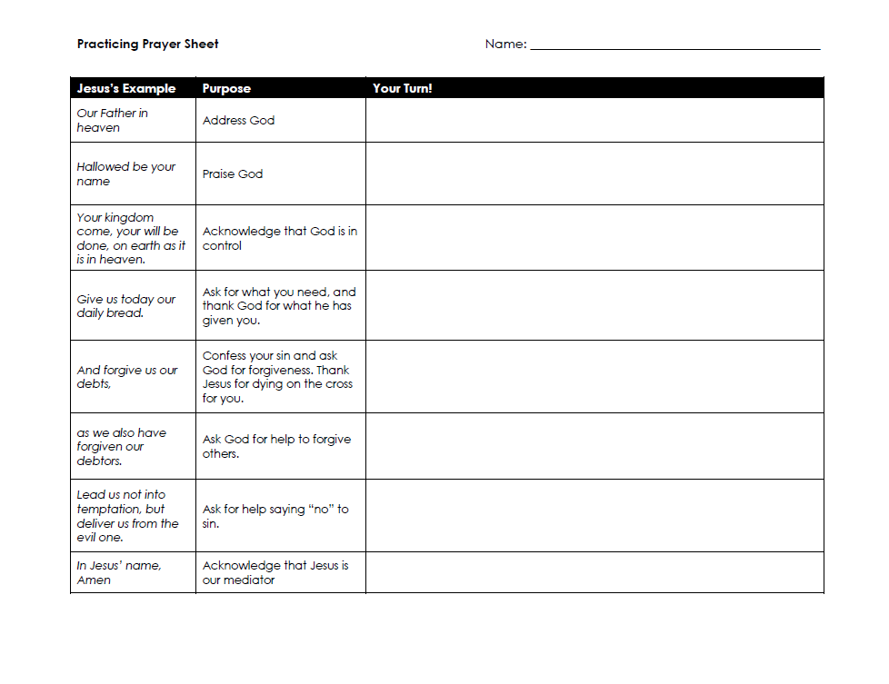
Notes:
Available to download if you wish on wpbiblefellowship.org/resources

Slide 7
Lord’s Prayer
Prayer Journal
Notes:
2. The next step was to purchase each of the kids a note book to use as a prayer journal. We started out with using the template of the Lord’s prayer, and then I moved on to the ACTS rubric.

Slide 8
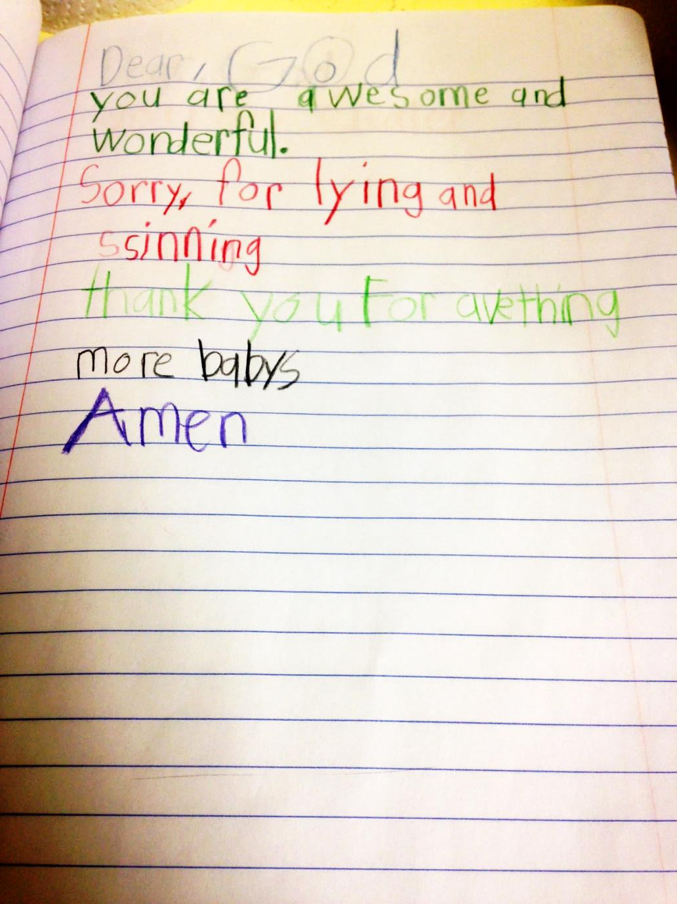
Notes:
ACTS
Adoration – Praise God for who He Is
Confession – Tell God your Sin and Ask for Forgiveness. Agree with him about how bad sin is
Thanksgiving – Thank God for things he has done for you and given you.
Supplication – Ask for the things you need.
I have the posters on the wall and then we write requests on coordinating colored sticky notes
Focuses their requests to different categories.
I talk them through giving examples.
After a while, I had the older kids lead the group
They could volunteer to close in prayer by reading their prayer.
Some kids struggle with reading/writing – I say, don’t worry about handwriting, spelling, punctuation. No one will see this, just write to God. Some kids still don’t like it ☺ I only do it once a month or so.

Slide 10
Notes:
I also encourage a free writing version of praying every once and a while.

Slide 11
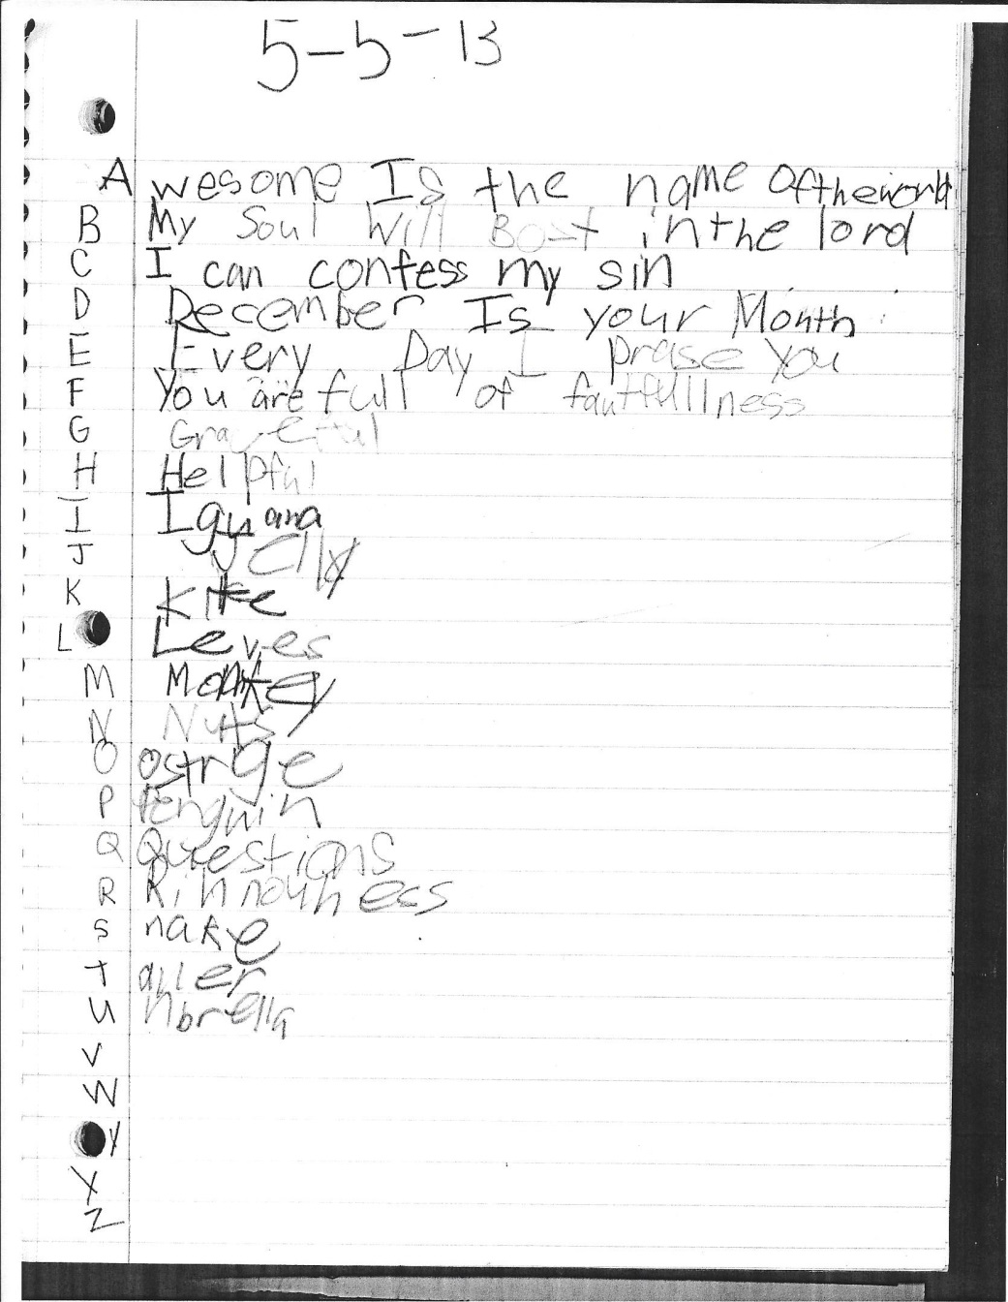
Notes:
Another variation I did was experimenting with some other ways to pray in a focused way:
Alphabet acrostics
Praying with scripture. This was probably too hard, but I think Daven did pretty good anyway.

Slide 12
Attributes of God
Introduce the Vocabulary
Go to the Scripture
Give Definition
Discuss to Test Understanding/Parse Nuance
Point out applications
Respond with worship
Notes:
One of the sections of the prayer was “Adoration” and I realized that many of the kids did not know what to “adore” God with. They would default to “Awesome” or “Wondrous.” So we started a study on the attributes of God using A. W. Tozer’s THE KNOWLEDGE OF THE HOLY as a rubric.
We started the series during our Wednesday night program – so more of our evangelistic ministry.
The series started with the concept of God being incomprehensible – just like AW Tozer starts his book.
Each night, I would
introduce the attribute, but not really define it – ask the kids to hypothesize what it meant. I would often briefly explain what it meant, but would turn to the scripture as soon as possible so that we could be informed by God’s word.
Hand out 3x5 cards that had verses that told us about the attribute for the kids to look up and read (they really liked this)
1 Samuel 15:29 “And also the Glory of Israel will not lie or change His mind; for He is not a man that He should change His mind.”
James 1:17 “Every good and perfect gift is from above, coming down from the Father of the heavenly lights, who does not change like shifting shadows.”
Hebrews 13:8 “Jesus Christ is the same yesterday and today and forever”
Malachi 3:6 “I the Lord do not change. So you, the descendants of Jacob, are not destroyed.”
Numbers 23:19 “God is not human, that he should lie, not a human being, that he should change his mind. Does he speak and then not act? Does he promise and not fulfill?”
After they would read each verse, we would get a clearer understanding of what the attribute meant. I tried to ask simple questions to test understanding: “So if God is Holy today, will he still be Holy tomorrow?”
At this point, I would spell the definition out as clearly as possible:
God never differs from himself
God never changes
He has never been less holy (or sovereign, powerful, gracious, etc.) than he is now
Used discussion questions to parse out the nuance:
Can God accidentally say one thing and do another? Or make a promise that he doesn’t keep? (No, God is not like us – he is creator – and thus, he will not ever change his mind or lie.)
Can we trust God to keep his promises to us? (Yes, completely. He is not inconstant.)
Is the God that created the universe the same God we pray to? (yes!)
Is the Jesus we know in our hearts the same Jesus that walked on the earth and died on the cross? (yes!)
Then, when applicable, I would point out possible applications:
Why is it comforting to know that God will never change? (We can trust his promises. We can be confident that we are truly justified by his grace, because we know that the standards won’t change tomorrow.)
How can we be more godly by not changing? (Being more trustworthy, faithful, not letting emotions and moods control us)
What happens when we don’t trust that God is unchanging?
For Younger Kids:
What kinds of things change? (seasons, animals, people)
How do you change? (grow older/bigger, learn new things, change your mind about preferences)
God never changes. He never needs to learn something new, he never changes his mind.
At the end, I liked to pray using the attribute as a focus. I didn’t tell them this, but I would use the ACTS model:
Adoration:
God you never change.
You are the same yesterday, today, and forever
Confession
Help me to trust that you are always faithful
Help me to be trustworthy and faithful like you.
Thanksgiving:
Thank you for always keeping your promises
Thank you for always taking care of us.

Slide 13
Notes:
Don’t run from the complexity.
Embrace mystery.
God’s sovereignty and our responsibility for salvation
Trinity
Incarnation
Inspiration of the scripture.
Answer any question.

Slide 14
Notes:
I made posters of all of the attributes, and they are posted on the wall so that we can refer to them in our lessons. They are downloadable on the resources webpage.

Slide 15
Notes:
Some close ups of the posters.

Slide 18
Notes:
Here is a prayer entry written after we studied some of the attributes.

Slide 19
New City Catechism
Notes:
Another tool I use for learning theology is catechisms and creeds.
Not necessarily Catholic, don’t be afraid of them, but use caution
You want to be careful with extra-biblical literature. I would never want to memorize more catechisms that we memorize scripture. I also often remind the kids that this isn’t in the Bible, it is written by a man, but it is a summary of what we believe based on the Bible.
What a catechism is useful for is remembering and understanding key concepts that we understand from our interpretation of the Bible as a whole; concepts that do not have just one verse that covers it in totality.
The catechism we use is
written by Timothy Keller and Sam Shammas.
Question/Answers
Adult version and Children’s versions

Slide 20
Notes:
I made a poster for each question and hung them on the wall (available at resources) also, the New City Catechism has a nice ipad app.

Slide 21
Notes:
Good questions with good answers.

Slide 22
Ministry Value
Group Learning
Large Passages
Notes:
Memorizing scripture is a huge part of our children’s ministry. All of our Children’s ministries include a portion of Memorizing Scripture
Hiding God’s word in our hearts (that we might not sin)
The Holy Spirit can use later in life - Be still and I know I am God (story)
Some fringe benefits
Kids love it when the pastor quotes verses they have learned
Strengthening verbal skills and broadening vocabulary
Tell the story of how we moved from competitive, individual scripture memory to group learning
Appeals to multiple learning styles
Sticks with them a long time.
Plug later workshop
We value long passages
Learning verses in context
Really understanding concepts because of so much repetition

Slide 23
Romans 11:33-36
Colossians 1:15-20
Philippians 2:5-11
Hebrews 1:1-4
Psalm 33
Psalm 34
Deuteronomy 30:11-20
Colossians 3:1-17
Isaiah 40:25-31
1 Chronicles 29:10-13
John 1:1-14
Romans 12:1,2; 9-21
2 Corinthians 5:11-21
Notes:
Cameron is in 5th grade, and he has memorized all of these, there may be more.

Slide 24
Attendance
Stewardship of their facilities
Encouragement
Notes:
Responsibilities for older children
I even like the preschoolers to “clean” their space
Cards for shut ins, thank you cards, thinking of you cards, Christmas cards for missionaries

Slide 25
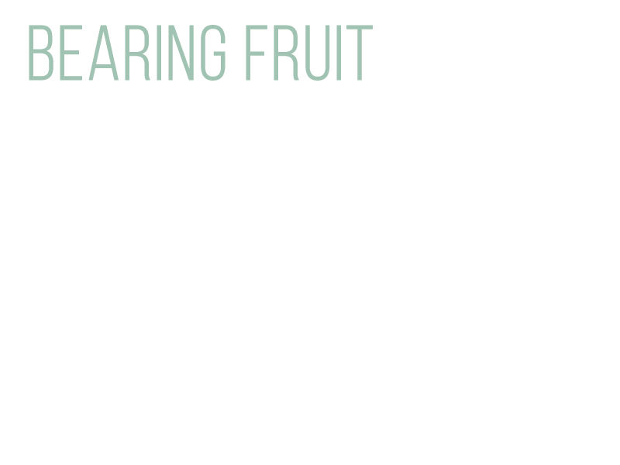
Addressing Sin
What if someone else gets a better snack?
What if you don’t get your way?
Valuing Heart Attitudes
Notes:
Don’t be afraid to “hit them where it hurts”.
Working with Preschoolers
Talking about the Beattitudes.
“You’re not being very poor in spirit!”

Slide 26
Sermon Notes for Young Disciples
Worship Service Code of Conduct
Notes:
We value having kids in the sermon
It is good for families to worship together
It is good to communicate the meta curriculum that
Church is important
the sermon is understandable

Slide 28
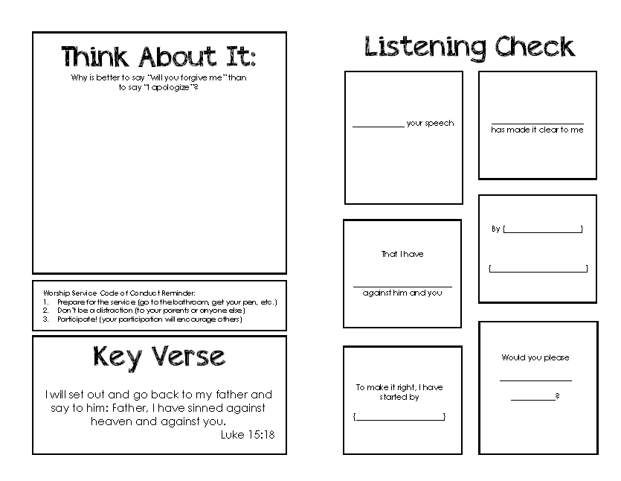

Slide 30
wpbiblefellowship.org/resources
For downloads, links, and other resources:

