Slide 1

Notes:
Introduction
A little about myself: My name is Becki Watson and I am the Director of Children’s Ministry at Wyoming Park Bible Fellowship.
Wyoming Park Bible Fellowship is located on the corner of Porter and Byron Center (so North of 28th St. between Byron Center and Burlingame).
I grew up at Grandville Baptist Church, that had a wonderful Children’s Ministry, and I think that is what inspired me to work with children. From a young age I desired to work with Children’s Ministry and to develop curriculum.
I started attending WPBF in 2005, when my dad was installed as pastor. At the time, the church had about 40 people in it. Most of the people were my dad’s age or older. At that point, we had 6 kids under 7th grade, and two of them were my younger siblings, and one baby.
The church had fallen upon difficult times and was renting out the building to two other churches. One, a Messianic Jewish church, used the building on Sundays, and another congregation used the church on Sunday mornings as well. So, while we had our worship service, the other church would have Sunday school in other rooms of the church. Then, we would share a fellowship time. While we had our Sunday School time, they would have their worship service. We actually shared a youth group, and our kids would leave our worship service to go to their Sunday School
The churches looked into merging, but doctrinal issues were too different, so eventually we were looking to become independent from the other churches’ rental income and ministries. Both churches found new facilities, and we now have the building to ourselves.
Over the course of the past 10 years, we have started a Sunday School classes for all ages. It currently consists of
A nursery (ages 0-2)
Preschool Pond (ages 2-5)
Young Disciples (K-6)
Our own youth group (7-12)
In just the next few months we are adding a new class for ages 4-6, so we are continuing to grow!
We also have a VBS every year (our 11th one is this summer)
A Wednesday Night program called Young Explorers for K-6
An annual Christmas program for all ages.
We are still small. Our Sunday School classes 0-6th grade averages about 12-15 total. Our Wednesday evening is about 20 kids.

Slide 2

Limited Budget
Limited Volunteers
Strong (or No) Traditions
Just a few kids
Big Age Span
“Extra Chair Sunday”
Notes:
Starting a ministry in a small church is especially hard. Whether you are in a church plant or a revitalization, you probably find yourself with:
Little (or no) money, so whatever you start or do has to be cheap. You don’t have money for new facilities. You don’t have money for curriculum. You have to just make something out of nothing. (I’ve been there!)
Little (or no) volunteers. Especially volunteers who are spiritually mature, have experience, and/or desiring a teaching position. Finding nursery workers is like pulling teeth, and all you expect them to do is babysit….so finding someone who wants to teach a lesson a weekly basis feels impossible. Not to mention a large team of volunteers to put on a VBS or special event.
Strong (or) Traditions. At our church, even though there wasn’t a Children’s Ministry in place, the members remembered what it used to be like. They used to have a bell choir, and certain things at the Christmas program, etc. I remember having a meeting with a church planter who described our position in a revitalizing church a “worst case scenario” because we had all these strong expectations/traditions to deal with AND we didn’t have any money. (Spoiler Alert: He was wrong. More about that later.) It can also be difficult to be in the church plant situation, where there is no tradition or expectation. Instead, you have to do a lot of soul searching and values clarification on your own. What is your children’s ministry going to look like? You will have to decide.
Just a few kids. Like 5 kids. Unless the Millers are gone, then you only have two. Spring Break week? Now you have no kids.
Big Age Span. The 5 kids you do have? One family has a 2 year old, 6 year old, and an 11 year old. The other family has a 5 year old and a 10 year old. Since there are so few kids, they all have to be in the same class. But the older kids hate having the younger kids in there, because it makes them feel like they are in the baby class. The little kids require so much attention, and often the lessons are over their heads.
“Extra Chair Sunday” – our church uses this term to describe the exciting day (someday in the future) that our church will have so many people that we have to pull out an extra chair. In the children’s ministry, though, extra chair Sunday comes every time someone brings their grandchildren to church. Or some kids stop in from the neighborhood. It only takes 2 extra kids to really upset the balance of a 5-person class. (Tell the story about the Carlisles bringing their 6 grandchildren, the 8 neighborhood kids last week, 4 families from Mars Hill).

Slide 3

Define the right “win”
  Your mission is to make disciples (not an amusement park)
  You are called to be faithful (not “successful”)
  You are not in charge (God is).
  Get started. Keep going.
Notes:
It can be very discouraging trying to start or grow a ministry in a little church. The challenges are real and unique, but the responsibility and mission is just as real and important as in a church of a larger size.
One of the most important things you need to do right off the bat is to define the right “win”. If you are expecting or working towards a ministry that has success defined by a huge turn out, ministry will get very depressing very quickly. Numbers are not everything. They may be not anything. Don’t tie your success with a certain number of kids that come out to Sunday school.
Remember what your mission is. We are to go into all the world and make disciples. I remember when I started out, I read a book that said that a children’s ministry should strive to be “the best hour in a kid’s week”. I understand the concept behind this, but this only made me insecure. I don’t have the resources to be the best hour in any kid’s week. Most my kids have an xbox and the Disney channel. I have coloring pages (maybe). But then I remembered that my mission wasn’t to entertain the kids. It wasn’t even to make church fun, really. My mission is to make disciples through God’s Word and his Spirit. (That doesn’t mean church can’t be fun, but you understand).
We are called to be faithful, not successful. You can do everything 100% right and still have no one show up to your event. You can also do a lot of things wrong and have a huge turn out. The point is, you can’t control what will happen, so you have to rest in God’s sovereignty, and just keep on keeping on. Keep doing the right thing, over and over, regardless of whether you have any outward success.
It has to be God, anyway, so it does not help to use emotional energy on worrying if things will work, or how you look. Just be faithful and God will take care of the rest.
Repeat this over and over. This is God’s kingdom. He will build it. “Unless the LORD builds the house, the builders labor in vain.” (Psalm 127:1)

Slide 4

Create the Infrastructure before it is needed.
  Child Protection Policy
    Resources
    Your Policy = Your Practice
  Procedures
    Registration
    Incident Reports
    Discipline
Notes:
Now that we are oriented in a healthy way, we are left with “where do we begin?” I believe very strongly that it is important to not get paralyzed in the planning phase. But there are a few things that you should have in place before you begin.
These are certain pieces of infrastructure that should exist before you need it.
A Child Protection Policy is not something you do not want to have to consider after you have had an incident. It is crucial that your ministry has thought through how you are going to ensure the safety of your children and how you are going to protect your volunteers from accusation.
Resources
One of the tools our church uses is MinistrySafe, which is a company that provides a number of resources for ministries in this area. Our church uses it particularly for an online training video that teaches volunteers how to detect and prevent abuse within the ministry. It also helps you create a database of your volunteers to keep track of background checks, and other milestones.
Your church insurance company often has a number of resources to help you develop a policy & procedures guide for your ministry. It is in their best interest for you to provide a safe environment, so they will be your friend when you are trying to set up infrastructure
Bonus – I will provide a copy of our church’s CPP as a starting point. It is a living document – always changing and adjusting as we have new ministries. For example, we started driving kids to and from our after school program recently, so we drew up a new set of guidelines for van drivers.
In essence, our church CPP can be summarized by three concepts: “Never alone, Never a secret, Never a Hint”.
Remember that your policy is only as good as your ability to comply with it. It doesn’t do any good to have a policy if your volunteers don’t know what’s in it, or if you cut corners on following it.
Along with the Child Protection Policy, it is helpful to have a few other things figured out before you start your ministry.
Your check in/check out procedures and registration forms for children attending your ministry are “must have” these days. Over the years we have perfected our registration forms and I will make those available to you online.
You don’t want to wait to figure out incident reports until you have an incident. It makes a bad situation look worse.
It is also helpful to think through what classroom controls you will employ in your ministry. (Tell story about how we came to need a formal discipline plan).
Our Rules: Nametags front and center, Follow Directions, Respect Everyone
Time Outs.
Kicking kids out.

Slide 5
Thriving in a One Room Schoolhouse
  Inspiring while Accommodating
  Be Serious, if not Complex
  Group Memorization
Thriving without Resources
  Teaching without Curriculum
  Keep the Main Thing the Main Thing
  Activate your Creativity
Notes:
Once you have some of the big things figured out, you are left with some practical, day-to-day challenges.
For example, what are you going to do with your five kids that span 10 years? Sometimes the only option is to embrace the “one room schoolhouse” model. You simply can’t justify smaller classes, so you have to keep them in the same class. I am here to tell you – from experience – that this is not only possible, it actually can be an effective learning environment and a valuable experience for the kids.
You have two main goals: you need to inspire the older kids (so they don’t feel silly being in the baby class) and accommodating to the younger kids (so that they don’t feel out of the loop).
Of the two, I think it is more important to make the older kids feel more comfortable. In my experience, kids really respond to high standards, responsibilities, and privileges that come with age. In my class, I have the certain jobs that only the older kids can do. Sometimes I have the older kids help the younger kids find their place in the Bible. The last thing you want to do is make the older kids do something embarrassing that’s more geared towards the younger kids.
In order to accommodate the younger kids, I enlist the help of the older kids. This teaches the older kids to be meek and helps them learn to serve. The younger kids like the attention from the older kids too. In some cases I do different activities for the younger kids that are less demanding. It is helpful to have a second helper to divide and conquer.
In the group lessons, your younger kids aren’t going to always understand things as well as the older kids do. When this happens, focus on communicating that whatever you’re saying is very important and serious. I think that the older kids really respond to this as well. They love it feels like they are being trusted with important information. Even if they don’t remember all the details about the lesson, they will remember that you, the teacher, thought that it was really important.
Another thing that I have found that works well with a variety of ages is group memorization. Younger kids tend to almost be better at memorizing than older kids, so tackling a memorization project as a group can feel a little bit like we’re all on the same level. The way I like to learn verses is in unison (plug upcoming workshop).
Another limitation we discussed earlier is limited budget and resources.
There may be a need to start a program, but you have no money for curriculum. If this is you, I encourage you to remember that we have everything we need in the Bible. You don’t need a written curriculum. (Don’t get me wrong – there are great curriculums out there, and if you want to take advantage of them, more power to you, but) I believe that if you are willing to study, you can open your Bible, and just read it to your students. Maybe you stop and explain things in a way that they can understand. But God’s word it living and active. These aren’t man’s words, and they have power. This how I teach today, and I love it that these kids are learning:
How to turn to a passage in question (I have them all open their own Bible…different editions, same translation); prepares them for sermon
That they can open their Bible and read it and understand it (talk about my boys who are reading ahead)
Limited budget means less money (or no money) for snacks, sports equipment, craft supplies, multi media, prizes, roller coasters, water slides, etc. This can be discouraging (talk about Children’s Ministry search on Pinterest). When you don’t have money for these things, go back to your mission. What is the most important thing your ministry should do? Make disciples. Not entertain. Not amuse. Not even attract. Just preach the gospel. So if all you have money for is one Bible, you have all you need.
I believe everyone is creative. Maybe in different ways, but everyone of us has the ability to create. We were created by a creative God. So use your creativity to fill the gaps you can’t fill with your built in budget. Make games out of milk caps, give new life to the old equipment you do have, find games that don’t require anything, etc.

Slide 6
Build Your Team
  Recruit Face to Face
  Trust God
  Celebrate
  Be a Good Leader
  Empower your Volunteers (for real)
Notes:
You can’t do it all by myself. You will need help to comply with your child protection policy. You will need help when you are sick or on vacation. You will need help as your ministry grows. Most importantly, the body of Christ is made up of various body parts – different talents, gifts, and strengths. Your ministry needs a variety of voices to be at its best. And, from another perspective, the body of Christ needs to be edified by being drawn together through service. In some ways, I have often through the people that get the most out of VBS is the volunteers: They get to get to know their fellow workers, they get to put their faith into action etc.
But how to get these extra volunteers? Have you ever tried putting sign up sheet on the bulletin board and hope people would just volunteer themselves? Have you watched that sign up sheet stay empty week after week? I would suggest:
Ask people in person to help out. Actually go up to them, explain what you would like them to do, and ask them to prayerfully consider it. It doesn’t really make sense, but I think sometimes people think it is bragging to volunteer to do something. It somehow feels more outgoing than their ready to be. I also hear a lot, “I wasn’t sure you needed me.” (???) People like to be asked individually. Don’t press them for an answer right away, and don’t pressure. But sometimes a face-to-face offer is a little harder to refuse.
Trust God: If you have done everything you can to get the volunteers you need, and you simply don’t have enough volunteers, maybe this ministry is something your church isn’t ready to pursue yet. Maybe it needs to be simplified or postponed. Trust God to supply the volunteers you need. (This may also mean being content with little old ladies instead of the college students you envisioned).
Celebrate your ministry. Periodically update your congregation about your ministry and events. Our church has a monthly scheduled celebration where we feature different ministries in the church. But if that is not an option, use a church blog, social media, or a church newsletter to keep people in the loop. When people understand that you are invested in making the ministry as good as possible, they will want to be involved. (Stories about VBS – when people saw how cool it was, they wish they would have been more involved. Bonus: they wanted to invite their grandkids/neighbors).
Be a Good Leader.
A good leader is organized and prepared.
A good leader models the right attitude (don’t apologize, and don’t gripe – explain how I learned this).
A good leader doesn’t make their volunteers’ jobs too hard.
A good leader doesn’t make their volunteers’ jobs too easy (which leads to…)
Empower your Volunteers (for real):
This is tough.
Make decisions when needed so that others can act (don’t have to wait for their approval)
Your job as a leader is to set the values, and make sure that your volunteers are inline with these values.
When a volunteer is in charge of something, he/she is really in charge. Let them sink or swim.
Embrace the diversity (this is so hard – but remember, choose your battles).
Let them get the glory. Learn to love second fiddle.
Because:
Empowered volunteers are passionate, invested volunteers
When you don’t empower, the ministry can never get bigger than you are.
When you don’t empower, your volunteers will never get the chance to learn and grow.
When you don’t empower, good volunteers will get frustrated and move on.
You can’t out-delegate God. If you work yourslef out of a job, rejoice. God has something else for you.

Slide 7
Spread the Word
  Brand Internally First
  Embrace Reality
  Find Your Method
  Define your Discipleship Process
Notes:
When it comes to advertising/promoting/marketing your ministry:
Brand Internally First: This is a marketing adage that means “advertise to the people inside your organization before you advertise outside it.” Your goal should be that everyone in your congregation knows and understands your programs so that they can direct any visitor and answer any questions. Nothing will get off the ground if you are the only person in the church that understands it.
Embrace Reality: I remember when I started working at our church, I would try to make our marketing look like it came from a bigger church. It was kind of subtle, but still kind of embarrassing. I tried to present our children’s ministry as if it was this huge, established program, when in fact, we were 5 kids in an empty room. This wasn’t helping anyone. There is value in being a small church. It’s exciting to be a part of a church that is growing. Don’t pretend to be someone you’re not – you’ll just discourage your people and disappoint visitors. With this in mind:
Represent your ministry as accurately as possible. Highlight the strengths you really do have.
Don’t hide your intentions (Do your VBS flyers advertise memorizing verses and learning about Jesus? Why?)
Own it, sister!
Find your method: What is the best way for you to advertise? Likely this will be different for each church, and will require some trial and error. For us, we love
grkids.com for advertising events
Flyers on the doors in the neighborhood for the VBS
Facebook Ads
Presence in community events
Define Your Discipleship Process: A Discipleship Process is the sequence or flow that you plan for people to move through on their way towards a greater involvement in the church, deeper relationship with God, becoming a disciple…

Slide 8
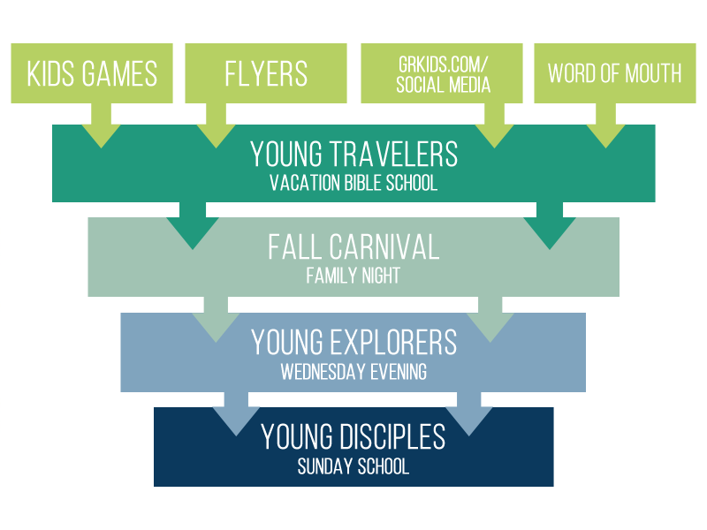
Notes:
This the discipleship process for our Children’s Ministry at our church. Obviously kids don’t always go through in the same order….sometimes kids come to Sunday School first and then eventually to the Wednesday Evening program, but in general,
We have various methods of advertising our VBS to kids for their first time
Our VBS, Young Travelers, is often the first time a child comes to one of our ministries. For this reason,
The purpose of Young Travelers is Evangelism. We talk about the gospel predominately.
We put more effort into advertising for Young Travelers than we do for the other ministries
We put more focus on fun, multi-media, being “attractive”
We invite all of our YT kids to the fall carnival, which happens the week before YE starts. This hopefully gets the family involved, and we get to meet parents.
The purpose of the Fall Carnival is just to reach out and connect with families, so we don’t have a formal Bible lesson, and that’s ok.
At the Fall Carnival, we invite all the kids to Young Explorers, our mid-week program.
The purpose of YE is predominately Evangelism, so we focus on the gospel, but we also go deeper in our Bible study, so it has elements of discipleship too.
We always invite our YE kids to the Sunday worship service and YD, our Sunday School class
The purpose of YD is predominately Discipleship, so we talk about the gospel (of course) but this is the group we go even deeper into our Bible Study (plug session 3 workshop)
Some Thoughts on the Discipleship Process:
You shouldn’t make all of your program/events Discipleship-only…you want to attract people who are new to church
You shouldn’t make all of your program/events Evangelism-only (Story about Attic After School / Youth Group)
Interestingly, I think that the we created YD first, and then YT second. YE third, and then Fall Carnival. You don’t have to have it all figured out immediately or before you get started, but think about it critically. Each of our ministries were a response to a perceived need.

Slide 9

Get Started
  Experience is an Excellent Teacher
  You can only go Up from here.
  Starting is always hard and scary.
  Set a date and stick to it.
Keep going
  Give it a chance.
Don’t stop
  “Maybe we should just cancel tonight . . .no one is coming anyway”
  “Let’s change the name/logo”
  “This isn’t what we expected. Lets start over.”
Notes:
Once you have some of the bare minimums down, it is important to get started. You probably want to think through a few more things than I mentioned on the last slide, but don’t let too much time pass in the “planning phase”
There have been many times when I let an awesome idea run out of steam because I was paralyzed by administrative details. I never felt “ready enough” to take the plunge and start. While preparation is necessary and beneficial, there comes a point in which you just need to start.
There are some things you can only learn through experience. I remember a steep learning curve when it came to advertising different events that I was planning at our church. It was only after each event that I was able to judge how effective the methods I had chosen really where. I even ended up discovering some methods were time-intensive but not effective. Sometimes you need to start your ministry – even when you’re afraid no one will come. At least you know something that won’t work.
You can always improve along the way. Of course the other side of this coin is that with each mistake you have added knowledge for next time. If I you wait until everything is perfect, you will never start. And if you did get everything perfect the first time, people would come and ruin it. ☺ Once you do start, you will be able to make adjustments. if you hold yourself to perfection at the beginning, nothing will ever happen.
Starting is hard and scary no matter how much preparation you do. You can research and schedule and plan forever, and you will still find it difficult that first time. Even if you know with certainty which college and major you want, that first day of class is going to be scary. And there will be times when you doubt your decisions. Allow yourself to be less than perfect because something is better than nothing.
Preparation and planning are important and (to me) fun. But as you prepare, set a date and stick to it.
In order for any ministry to get off the ground, there are two steps that must take place: Get started, keep going. No one has ever found a way to skip these steps, but we overlook their significance. They are the two most important (and most difficult) steps to starting any ministry. If you thought getting started was hard, this second part is even harder. Once a ministry has started, and the excitement of the launch of the planning is over, the work of the ministry really begins.
Give it a chance. No ministry will ever really take off until you have given your church and neighborhood an opportunity to get to know it. Success comes slowly. So the key is to not undercut the work you have already done by being inconsistent.
So don’t stop. Don’t give in to:
“Maybe we should just cancel tonight…” When you get a poor turn out to your ministry, it starts to feel like the effort isn’t worth the benefit, and you begin to wonder if there is any hope for improvement. It just seems easier to quit or take breaks. But the truth is, attendance will never get better unless you prove that you’re consistent. Your audience has to trust you that you’re always going to be there before they will commit. it only takes one time for someone to attend your ministry on a week that you cancelled to lose that trust.
“Nothing is happening with this ministry…maybe we should come up with a new name/logo.” You’re bored, and you want to experience the fun planning stage again. This might result in unnecessary name and logo changes (I am guilty of this). But keep in mind that when you start over, you start everything over. You lose all the value of your previous work. Branding relies on consistency over a long period of time. When you change the brand, you are starting at square one. It might as well be a brand new ministry. Remember that success comes slowly. If you change your branding before your ministry has a chance to catch on, you may never see the fruits of your labor. Important changes are often necessary as a ministry and grows, but let me encourage you that the more you can keep consistent, the stronger your “brand image” will be. Stick to your guns.
“This ministry isn’t really doing things we advertised it would do. Maybe we should start over.” The ministry isn’t turning out how you expected, and you feel like the marketing you started with doesn’t fit your current ministry. (Example: Parrhesia, Open Air, Crafts at AAS) You want to change the name or logo because (to you) they aren’t congruent with the actual ministry. Remember that branding is, in reality, the least important aspect to your target audience once they’ve committed to attending. Sometimes God has a different plan for your ministry than you had for it. Allow Him to change the focus of the ministry if he sees fit. Make sure that you are holding tightest to the most important things (the gospel) ad looser to everything else (demographic of attenders, the time it meets, etc.)

Slide 10
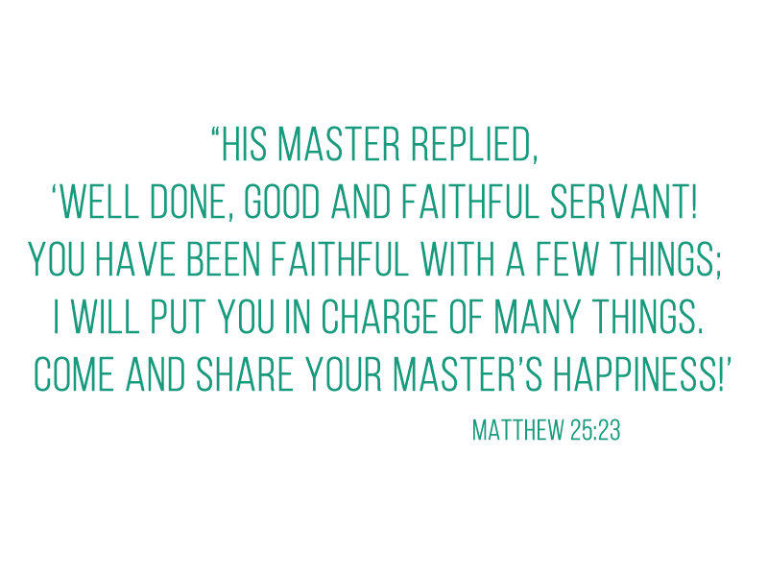
Notes:
No matter what kind of ministry you have started, ministry is hard. Broken people, attacks by the enemy, the offense of the gospel – Jesus never promised us that it would be a walk in the park. In fact, he more often predicted suffering in our futures. We are going to encounter persecution, exhaustion, insult, and, if nothing else, under-appreciation.
Endure through these hardships. Find comfort and joy in that you get to do hard things for Jesus, and refresh your soul in his grace. Whatever you do, don’t give up.

Slide 11
wpbiblefellowship.org/resources
For downloads, links, and other resources:

