Slide 2
Systematic Theology
An organized approach to studying God
Defining a language that we use to speak about God and his Word.
Creating building blocks for understanding God and his Word

Slide 3
Why might a person be hesitant to teach systematic theology to children?

Slide 4
Why is it important to teach systematic theology to children?
It’s our calling as teachers of God’s Word.
It’s happening anyway.
To know God, we must study him.
It is the truth and Jesus that facilitate our sanctification.

Slide 5
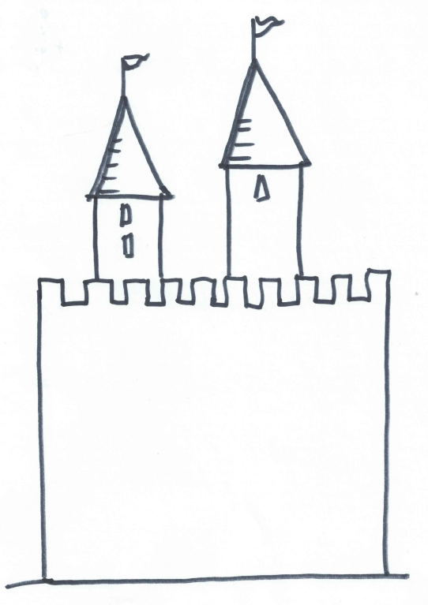
Actions
Habits
Vocation
Attitudes
Culture
Relationships
Pleasure / Emotions
Perceptions / Reasoning
lie
Values / Treasure
Core Beliefs

Slide 6
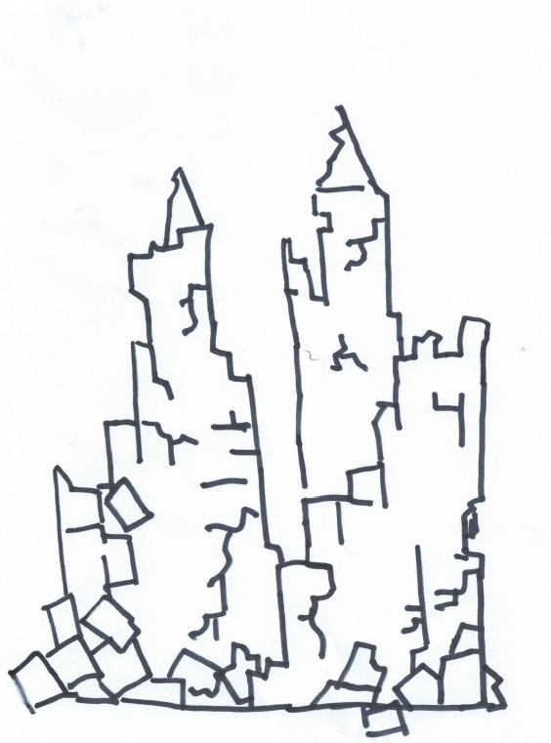
Actions
Habits
Vocation
Attitudes
Culture
Relationships
Pleasure / Emotions
Perceptions / Reasoning
lie
Values / Treasure
Core Beliefs

Slide 7
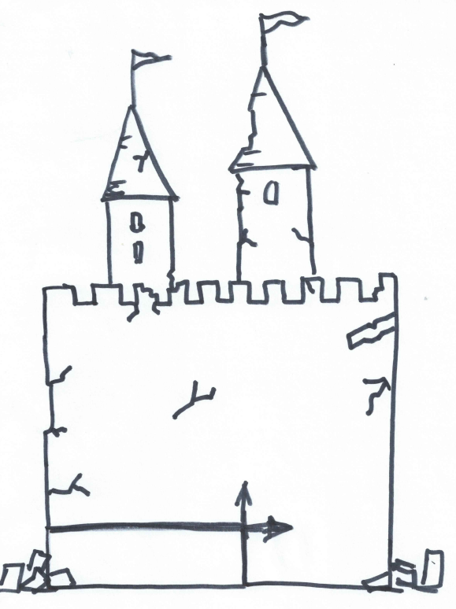
Actions
Habits
Vocation
Attitudes
Culture
Relationships
Pleasure / Emotions
Perceptions / Reasoning
Values / Treasure
Core Beliefs
Jesus
Truth

Slide 8
How to start teach Systematic Theology
Learn it yourself.
Start small.
Gently correct misconceptions.
Invite hard questions, then demonstrate how to find the answers.
Memorize key scriptures.

Slide 9
How to start teach Systematic Theology
Memorize a creed or catechism.
Pull out truths from Bible Study
Don’t be afraid to have your main “take home” point be a truth about God.
Make a schedule.
Learn together.

Slide 10
Age Groups
Nursery (Under 2)
Preschool (Ages 3-4)
Kindergarten (Ages 5-6)
Primaries (Grades 1st-3rd)
Juniors (Grades 4th-6th)
Vacation Bible School
Youth Group (Grades 7th – 12th)

